Slide 1
Capstone Project: The Battle of Neighbourhoods

Slide 2
Introduction
1.1 Description of the Problem
The population of London has grown considerably over the last decades. London is very diverse. It represents what is called the reflection of the old British Empire. In London, you can get fresh food supplies from Africa. One begins to wonder how efficient the supply mechanism is.
The real deal is that as much as there are many fine restaurants in London – Asian, Middle Eastern, Latin and American restaurants, you can struggle to find good place to dine in the finest of West African cuisine that has combination of Nigerian, Ghanaian, Cameroonian, Senegalese and more.
Eating in a cozy environment with a blend of multicultural background and finely made West African dishes, on time and on point in a London location accessible to tourists, within central London and not far from the "unofficial" capital African market place - Peckham.

Slide 3
2. Data
The London Area consists of 32 Boroughs and the "City of London". Our data will be from the link - Greater London Area <https://en.wikipedia.org/wiki/List_of_areas_of_London >
London is big and due to the limitations in the number of calls for the Foursquare API, the following assumptions are made to confine this project to only South East London.

Slide 4
Assumption 1: Where the Postcode are more than one, (for example, in Acton, there are 2 postcodes - W3 and W4), the postcodes are spread to multi-rows and assigned the same values from the other columns. Assumption 2: From the data, only the 'Location', 'Borough', 'Postcode', 'Post-town' will be used for this project. So they are extracted into a new data frame
 | Location | Borough | Postcode | Post-town
0 | Abbey Wood | Bexley, Greenwich | SE2 | LONDON
1 | Acton | Ealing, Hammersmith and Fulham | W3 | LONDON
2 | Acton | Ealing, Hammersmith and Fulham | W4 | LONDON
3 | Angel | Islington | EC1 | LONDON
4 | Angel | Islington | N1 | LONDON
Figure 1: Dataframe after assumption 2

Slide 5
Assumption 3: Now, only the Boroughs with London Post-town will be used for our search of location. Therefore, all the non-post-town are dropped.
Assumption 4: Due to its more diverse outlook, proximity to afro-Caribbean markets and accessible facilities, only the South East areas of London will be considered for our analysis. The South East areas has postcodes starting with SE.
Assumption 5: This assumption will focus on the demography of London where there are predominantly more multicultural groups. According to the proportion of races by London borough as seen in Demography of London,
Assumption 6: This assumption will be based on the top 5 areas will significantly high "Black", "Mixed" and other races. These leaves us with Lewisham, Southwark, Lambeth, Hackney and Croydon.

Slide 6
Then we proceed to store the location data - latitude and longitude as follows.
 | Location | Borough | Postcode | Latitude | Longitude
0 | Crofton Park | Lewisham | SE4 | 51.46268 | -0.03558
1 | Denmark Hill | Southwark | SE5 | 51.47480 | -0.09313
2 | Deptford | Lewisham | SE8 | 51.48114 | -0.02467
3 | Dulwich | Southwark | SE21 | 51.44100 | -0.08897
4 | East Dulwich | Southwark | SE22 | 51.45256 | -0.07076
Figure 2: Location with Latitude and longitude after the application of all the mentioned assumptions

Slide 7
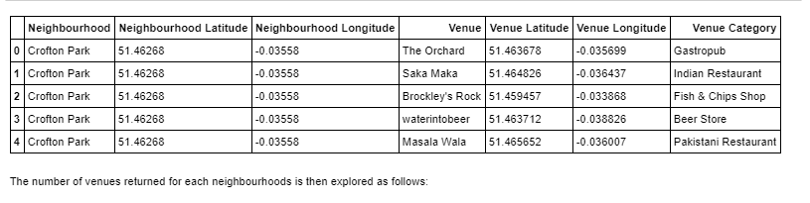
Multiple Neighborhoods
Now let's explore (Multiple) Neighborhoods in the South East London area.
To do this, the function getNearbyVenues is used and it's created to repeat the same process for all neighborhoods.
Figure 3: Top 5 neighbourhood with latitude and longitude

Slide 8
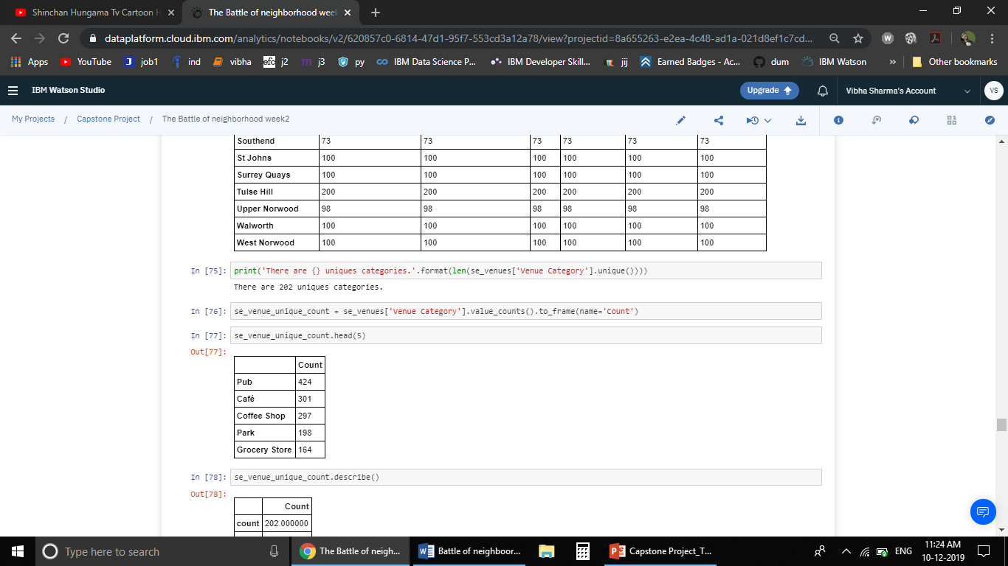
Count of Pub, café, coffee shop, parks , Grocery shops in the neighbourhood
Figure 4:From 202 unique categories ,top 5 categories are shown in the output

Slide 9
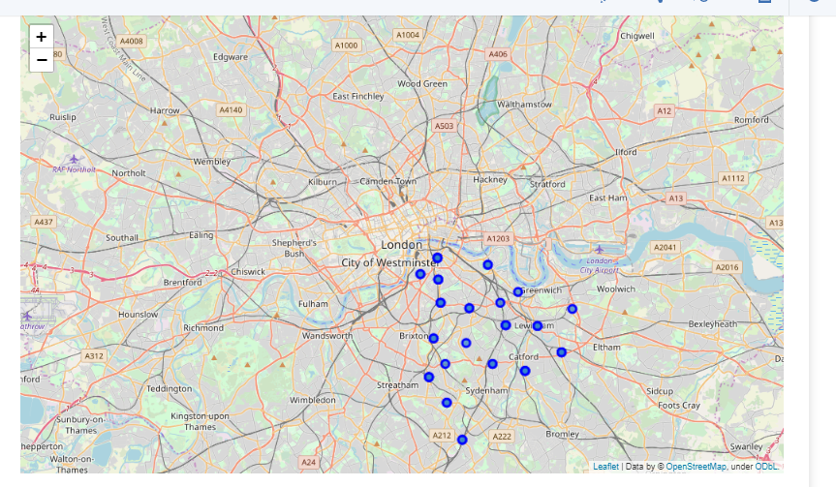
Map Visualization
Figure5: Highlighted neighbourhood of London

Slide 10
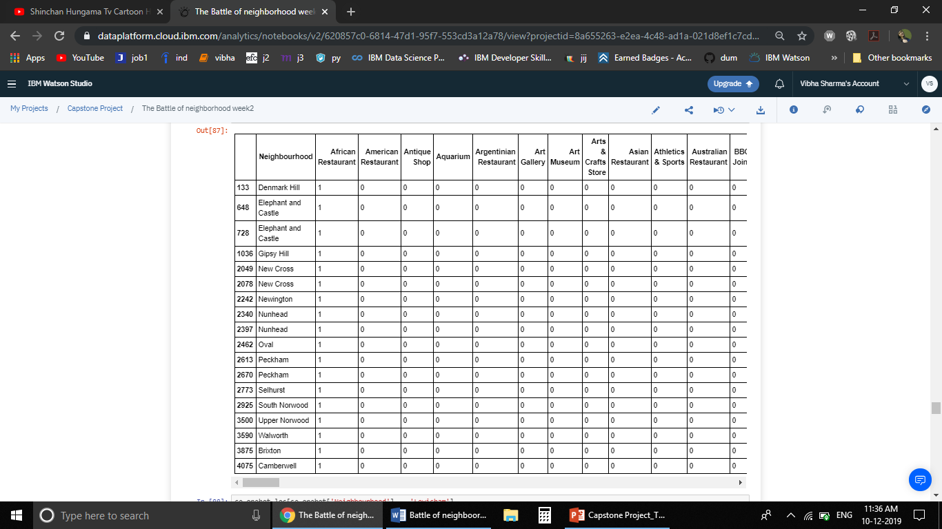
Analyzing Each Neighborhood
In this section, the objective is to
check and explore the venues in
each neighborhood.
One Hot Encoding
All the venues will be displayed in the output along with the locations in the neighborhood
Similarly ,all the venues will be show in the output for the neighborhood “Lewisham”
Figure 6 : Sample of Output after One hot Coding

Slide 11
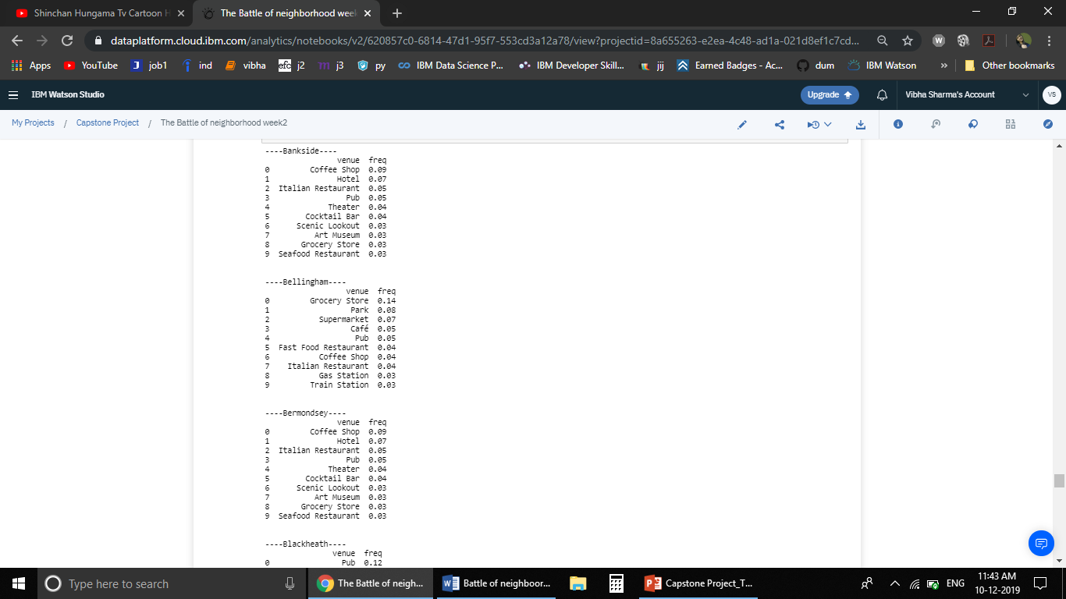
Regrouping and Category Statistics
After regrouping , for each neighbourhood all the categories with frequency will be displayed in the ouput
Figure 7 : Sample of Output after Regrouping

Slide 12
Clustering of Neighbourhoods
Optimal Number of Clusters for K-mean
To get the optimal number of clusters to be used for the K-mean, there are a number ways possible for the evaluation
Elbow (Criterion) Method
Silhouette Coefficient

Slide 13
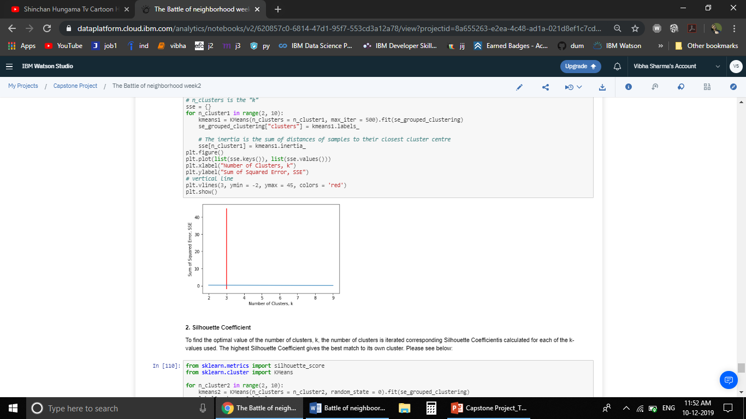
The elbow method is used to solve the problem of selecting k. Interestingly, the elbow method is not perfect either but it gives significant insight that is perhaps not top optimal but sub-optimal to choosing the optimal number of clusters by fitting the model with a range of values for k.
Figure 8: Elbow Coefficient

Slide 14
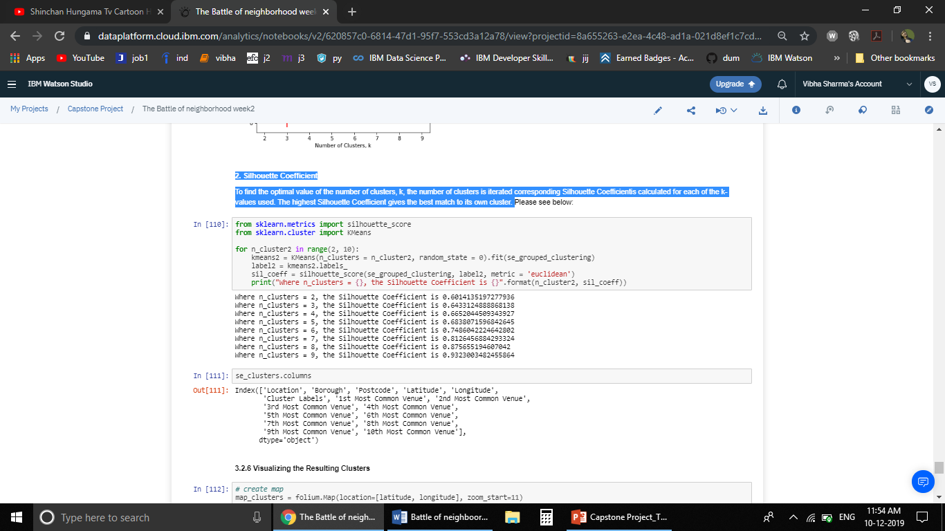
2. Silhouette Coefficient
To find the optimal value of the number of clusters, k, the number of clusters is iterated corresponding Silhouette Coefficient is calculated for each of the k-values used. The highest Silhouette Coefficient gives the best match to its own cluster.
Figure 9: Silhouettee Coefficient

Slide 15
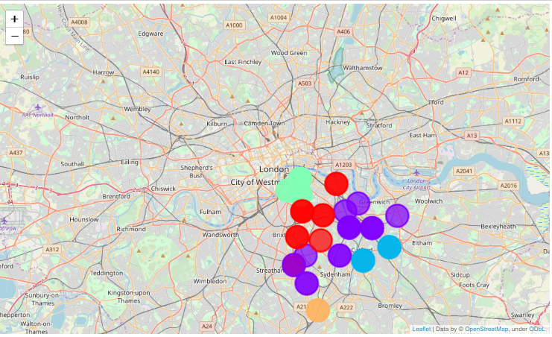
Visualizing the Resulting Clusters
Figure 10 : Visualizing the Resulting Clusters

Slide 16
Result
The following are the highlights of the 5 clusters above:
Pubs, Cafe, Coffee Shops are popular in the South East London. As for restaurants, the Italian Restaurants are very popular in the South East London area. Especially in Southwark and Lambeth areas. With the Lewisham area being the most condensed area of Africans in the South East Area, it is surprising to see how in the top 10 venues, you can barely see restaurants in the top 5 venues. Although, the Clusters have variations, a very visible presence is the predominance of pubs.

Slide 17
Conclusion
In conclusion, this project would have had better results if there were more data in terms of crime data within the area, traffic access and allowance of more venues exploration with the Foursquare (limited venues for free calls).
Also, getting the ratings and feedbacks of the current restaurants within the clusters would have helped in providing more insight into the best location.

Slide 18
Thank you
☺
Any questions?

